Slide 1

LOCATION FINDER
Project Name

Slide 2




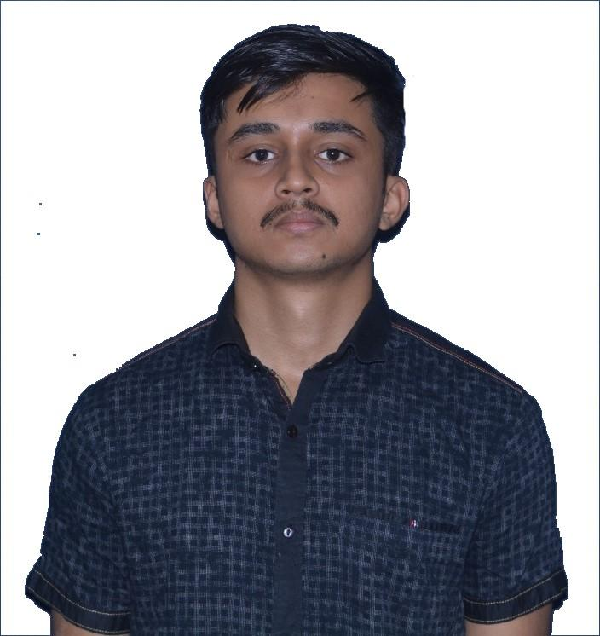
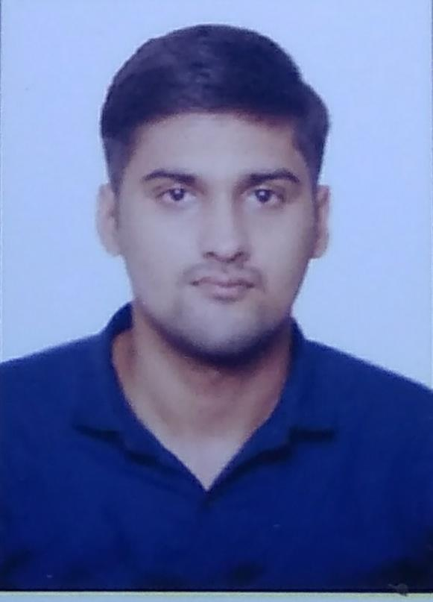
REGENT EDUCATION AND RESEARCH FOUNDATION
GROUP MEMBERS
GUIDE NAME
ANUSHREE SAHA
26300119006
MR. ATANU KUMAR DAS
MANISH PATHAK
26300119026
SHIVAM MISHRA
26300119025

Slide 3

ACKNOWLEDGEMENT
We would like to express our gratitude to our project mentor Mr. Atanu Kumar Das Sir for providing support and guidance.
We would also like to express our gratitude to our HOD Mr. Subhankar Ghosh Sir.

Slide 4

INTRODUCTION
Our project aims to develop a location-finding system using image EXIF data. Traditional methods rely on text-based inputs, but our innovative approach leverages image metadata to retrieve accurate location information. By analyzing the EXIF data embedded in images, such as latitude, longitude, and altitude, our system can determine the location and provide relevant information and routes. This technology opens up new possibilities for seamless and intuitive location search, especially in scenarios where users prefer image-based inputs. With our project, we aim to revolutionize the way users find locations by making it simpler, more visual, and efficient.

Slide 5
PROBLEM STATEMENT
The problem we aim to solve is the inefficiency and limitations of traditional location finding methods that rely solely on text-based inputs. Users often face challenges in accurately searching for locations by manually typing place names or addresses, which can be time-consuming and prone to errors. Furthermore, existing systems do not effectively utilize the valuable information stored in image EXIF data, such as latitude, longitude, and altitude, resulting in a missed opportunity for seamless and intuitive location searches. Our project seeks to address these issues by developing a solution that leverages image EXIF data to enhance the accuracy, efficiency, and user experience of location finding.

Slide 6
SOLUTION OVERVIEW
Our project aims to revolutionize the process of location finding by leveraging image EXIF data to provide an intuitive and accurate solution. We propose a system that analyzes the metadata embedded in images, such as latitude, longitude, and altitude, to extract location information.
The solution consists of several key components. Firstly, the user interface allows users to upload an image as an input for location finding. The system then extracts the relevant EXIF data from the image, including coordinates and other location-related information.
The next component is the image processing module, which performs the necessary calculations and data manipulation to extract the precise location information from the EXIF data. This module ensures accurate interpretation of the image metadata and minimizes errors or inconsistencies.
Once the location information is obtained, it is compared with a comprehensive location database. The database contains a vast collection of geographical data, including place names, addresses, landmarks, and routes. By matching the extracted location information with the database, the system identifies the exact location associated with the image.

Slide 7
The final component is the output module, which presents the location information to the user in a user-friendly format. This can include displaying the location on a map, providing directions, or offering additional details about the place.
Our solution offers several advantages over traditional location finding methods. By utilizing image EXIF data, it eliminates the need for manual typing of place names or addresses, streamlining the process and reducing errors. The visual nature of image-based inputs also enhances the user experience and provides a more intuitive way of finding locations.
Moreover, our solution caters to various scenarios where text-based inputs may be impractical or time-consuming. For instance, when exploring unfamiliar areas, users can simply capture an image and retrieve location information instantly. Additionally, it can be particularly useful in cases where users are unable to accurately describe a location in words but have a visual reference.
Overall, our solution offers a novel and efficient approach to location finding by harnessing the power of image EXIF data. It simplifies the process, improves accuracy, and enhances the user experience, providing a valuable tool for both personal and professional use.

Slide 8

What is EXIF Data?
Exchangeable Image File Format (EXIF) is a standard that defines specific information related to an image or other media captured by a digital camera. It is capable of storing such important data as camera exposure, date and time the image was captured, and even GPS location.
Nowadays, every modern digital camera has the capability to record this information, along with many other camera settings and other relevant data, right into photographs. These settings can then be later used to organize photographs, perform searches, and provide vital information to photographers about the way a particular photograph was captured. Such stored data is called "EXIF Data", and it is comprised of a range of settings such as ISO speed, shutter speed, aperture, white balance, camera model and make, date and time, lens used, focal length, and much more.
After putting all this information in a place and linking them up, we finally got the objective for our project and decided to work on it.

Slide 9
OBJECTIVE : To find a location using photos through its metadata.
The objective of this project is to develop a location finding system using image EXIF data. The primary goal is to provide users with an alternative method of finding the location and route of a place by using an image as input instead of text-based search. By extracting and analyzing the EXIF data embedded in the image, including altitude, longitude, and latitude information, the system aims to determine the location and provide accurate results.
The project also aims to enhance user experience and convenience by offering a unique and intuitive way to search for locations. The objective is to simplify the process and eliminate the need for manual input of place names or addresses. By leveraging image processing techniques and extracting relevant location information, the system can provide quick and accurate results, reducing the effort and time required for location-based searches.
Additionally, the project aims to showcase the potential of utilizing EXIF data in applications beyond traditional photography, demonstrating the versatility and value of this information in the context of location-based services.
Overall, the objective is to develop a robust and user-friendly location finding system that leverages image EXIF data, offering an innovative and efficient way for users to discover the location and route of places of interest.

Slide 10
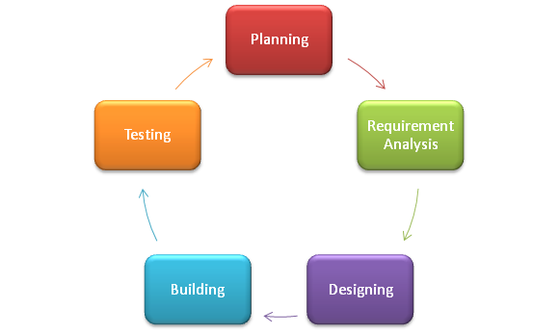
AGILE SOFTWARE DEVELOPMENT LIFE CYCLE
The agile software development lifecycle of this project embraces iterative and incremental development. The software development lifecycle encompasses key stages such as requirement gathering, system design, coding, testing, deployment, and maintenance. It follows an iterative and incremental approach, allowing for feedback and adaptation. This ensures the development of a robust and functional location finding system using image EXIF data, meeting user requirements and industry standards.This iterative approach allows for flexibility, faster delivery of features, and the ability to incorporate changes and enhancements based on evolving needs.

Slide 11

OUR PLAN
PHASE–1
PHASE–2
PHASE–3
Writing code for extracting exif data from images
Storing coordinates of the place from given image
Taking coordinates as input and showing the place where image was taken on the map
Creating an user-friendly interface for our project

Slide 12

SOFTWARE USED
1. Integrated Development Environment (IDE): An IDE is a software application that provides a comprehensive environment for developers to write, test, and debug their code. Here we used VS Code’s IDE for Python.
2. Image Processing Libraries: Since the project involves processing images and extracting their exif data, image processing libraries such as Pillow is used here.
3. Web Framework: A web framework named as Flask is used to build the web application, define routes, handle user requests, and perform server-side logic.
4. Front-end Technologies: HTML, CSS, and Bootstrap is used to create a responsive and visually appealing user interface.
5. Deployment Tool: Microsoft MAP API has been used as a deployment tool.

Slide 13

FLOW CHART

Slide 14
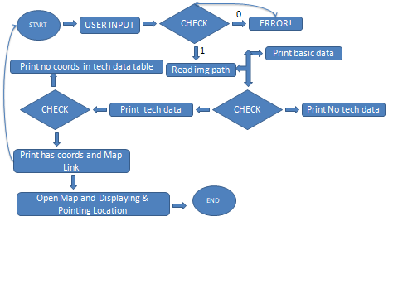

Slide 15
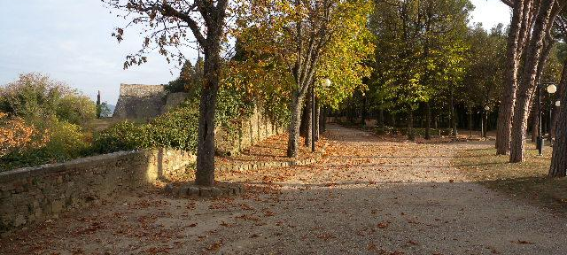
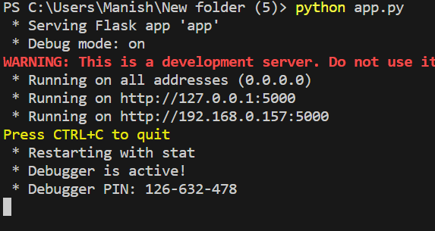
SNAPSHOTS
Programming language:-- Python,Html,Css,BootStrap,JavaScript
The Python library used in this project is
Exif, Pillow , Flask .
For this project, we will use this photo

Slide 16
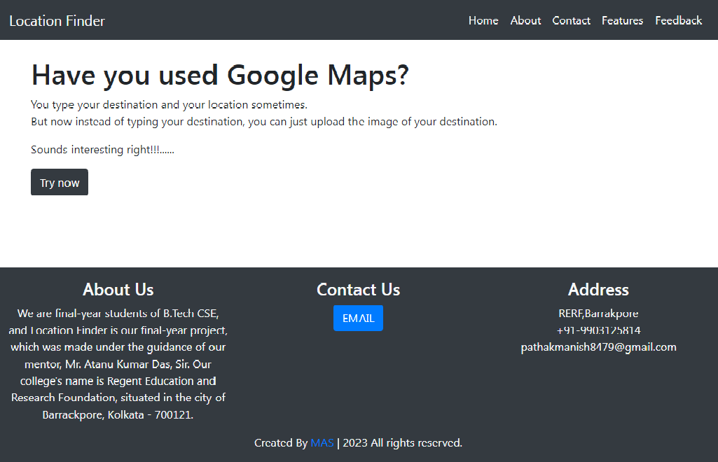
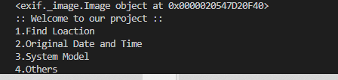
WE ARE CONVERTING IMAGE PATH INTO BINARY

Slide 17
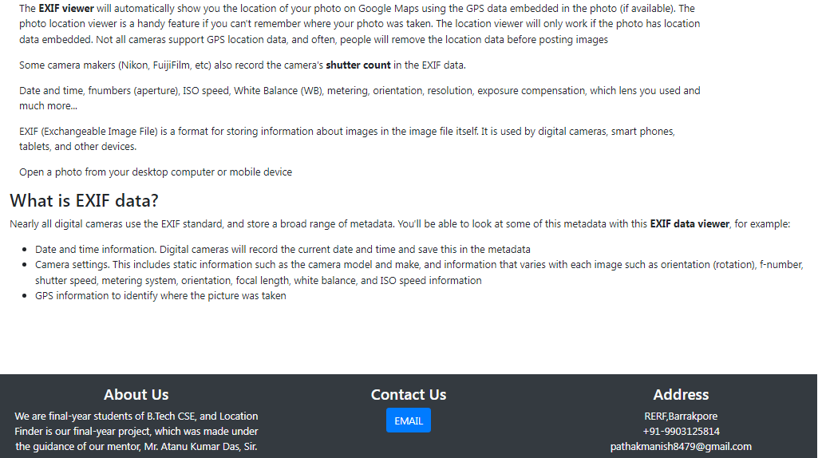
WE ARE CONVERTING IMAGE PATH INTO BINARY

Slide 18
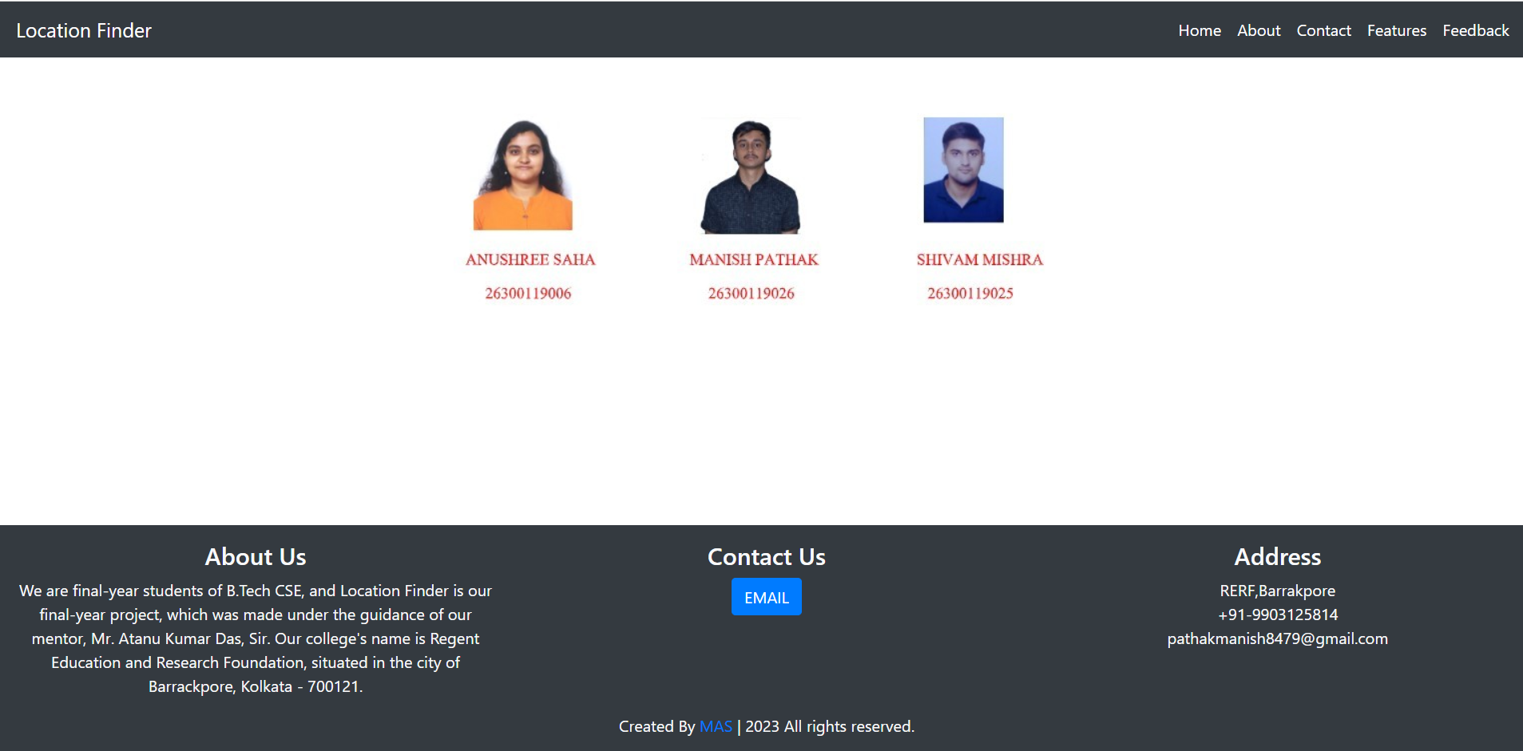
WE ARE CONVERTING IMAGE PATH INTO BINARY

Slide 19
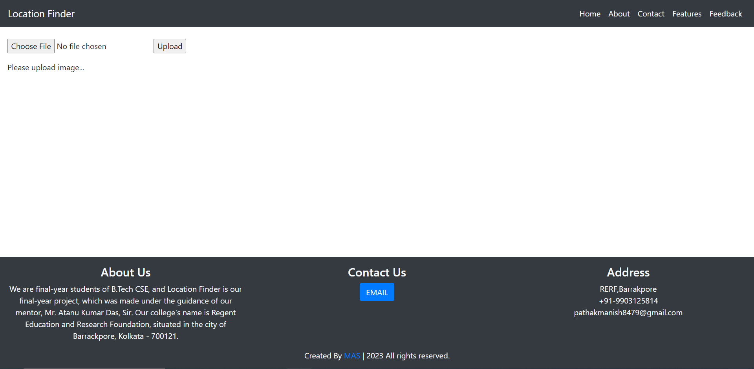
WE ARE CONVERTING IMAGE PATH INTO BINARY

Slide 20
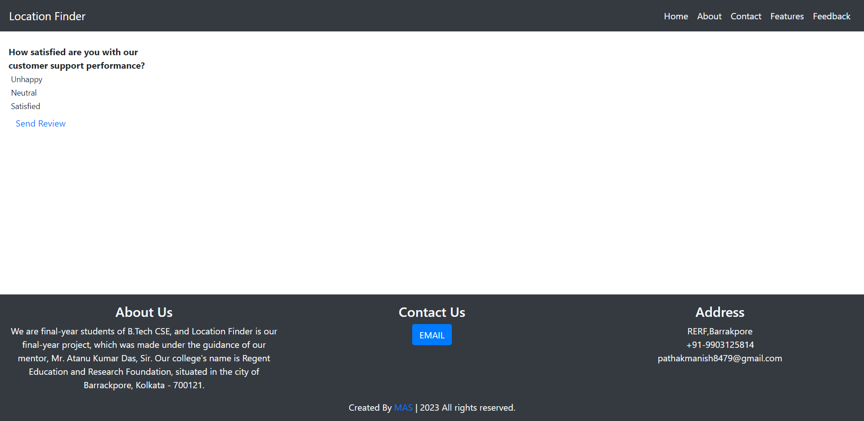
WE ARE CONVERTING IMAGE PATH INTO BINARY

Slide 21
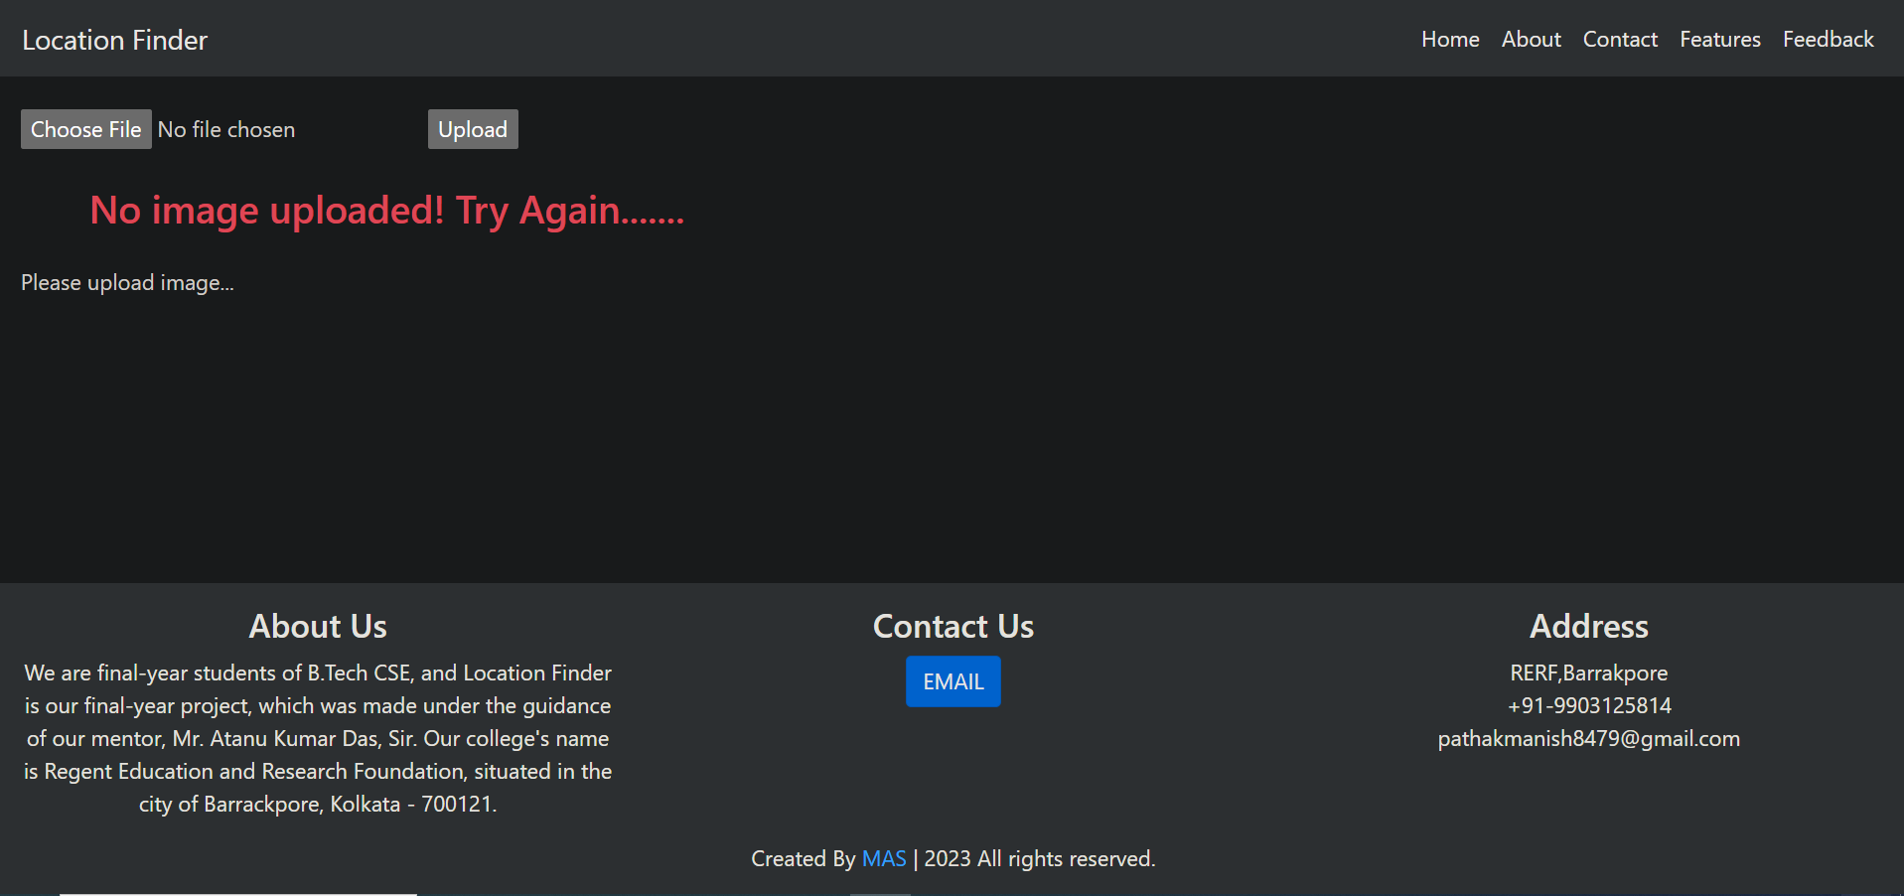
WE ARE CONVERTING IMAGE PATH INTO BINARY

Slide 22
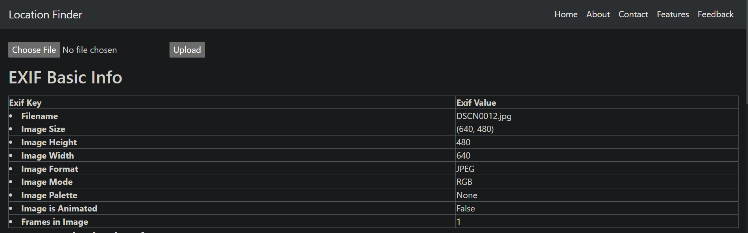
WE ARE CONVERTING IMAGE PATH INTO BINARY

Slide 23
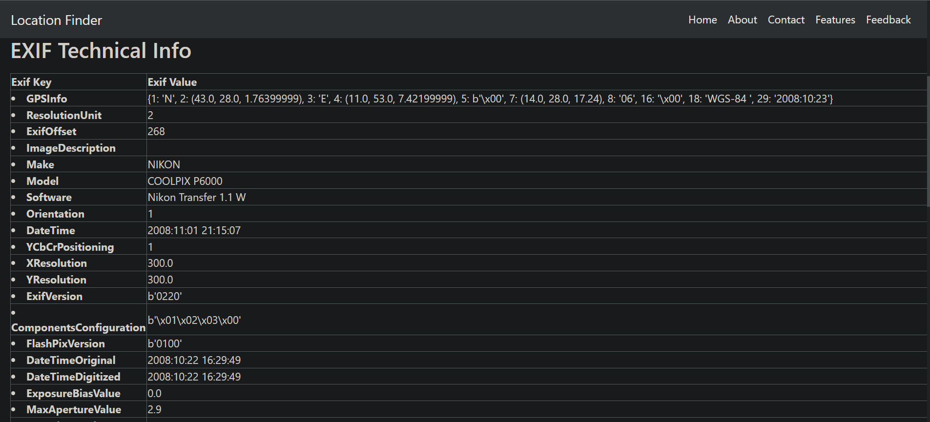
WE ARE CONVERTING IMAGE PATH INTO BINARY

Slide 24
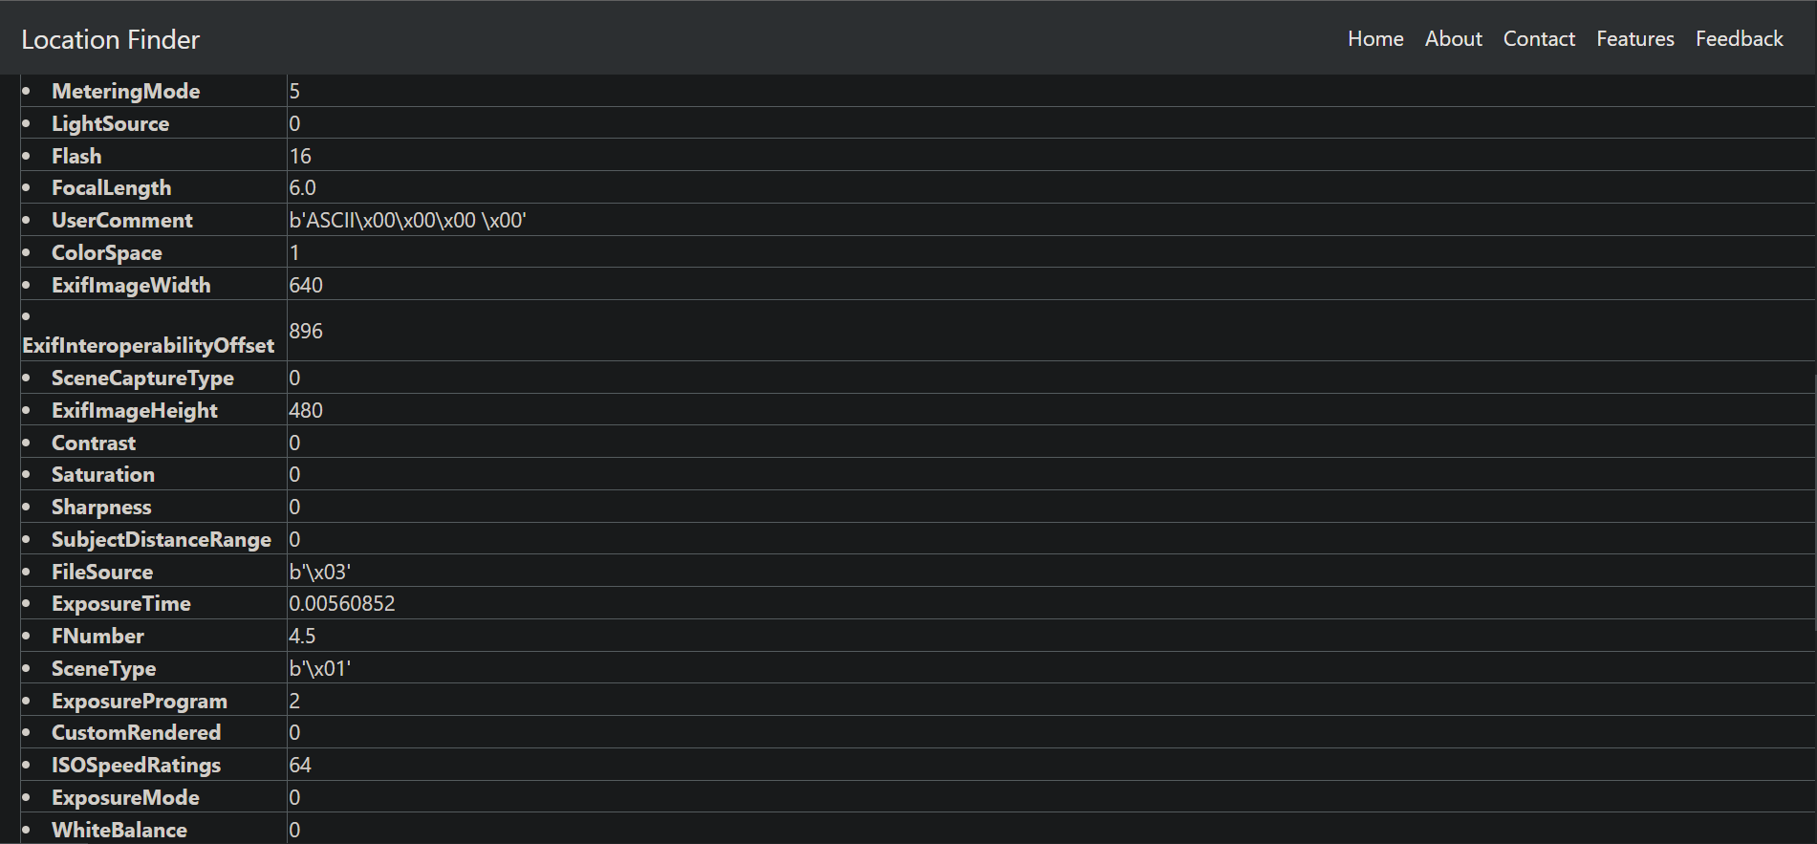
WE ARE CONVERTING IMAGE PATH INTO BINARY

Slide 25
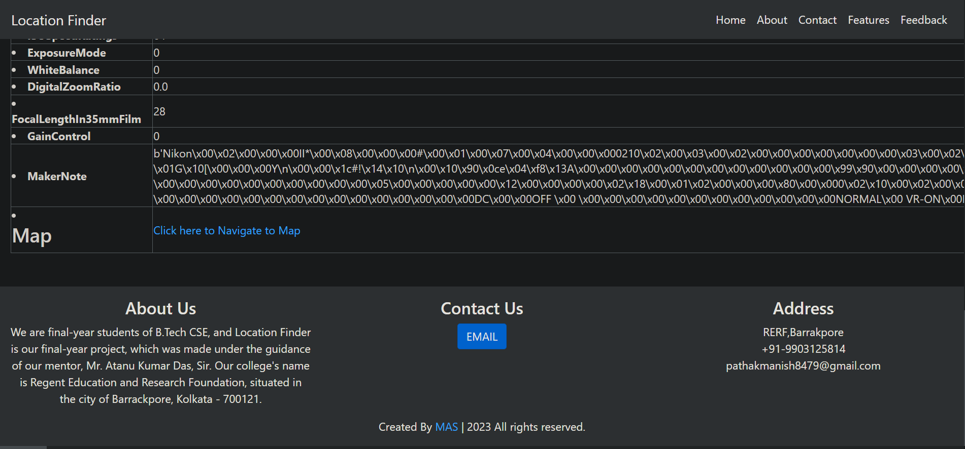
WE ARE CONVERTING IMAGE PATH INTO BINARY

Slide 26
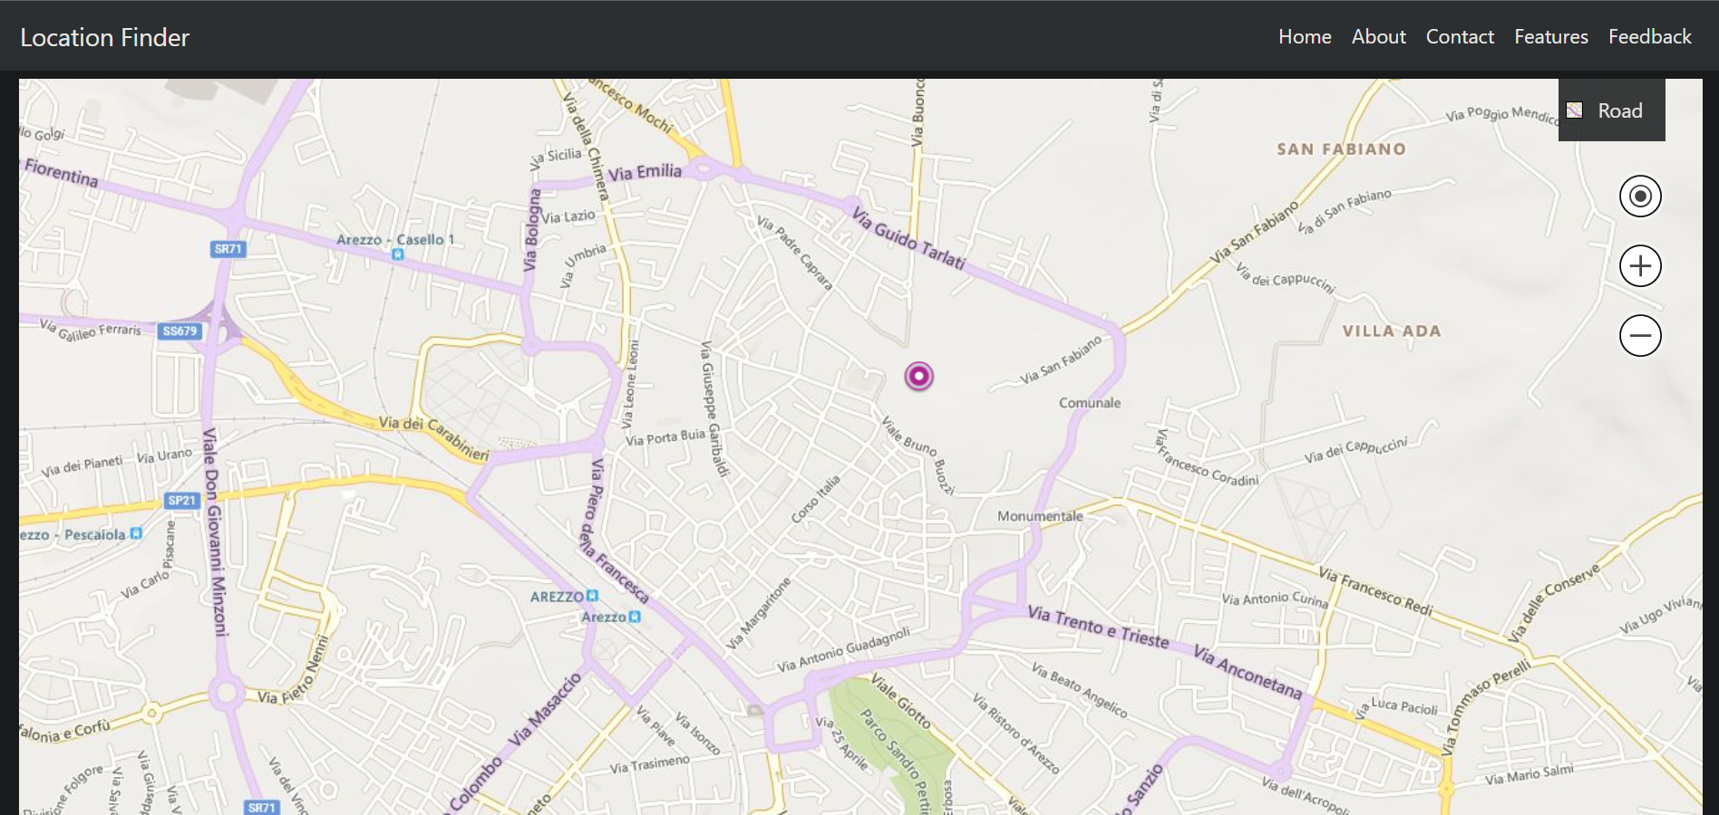
WE ARE CONVERTING IMAGE PATH INTO BINARY

Slide 27
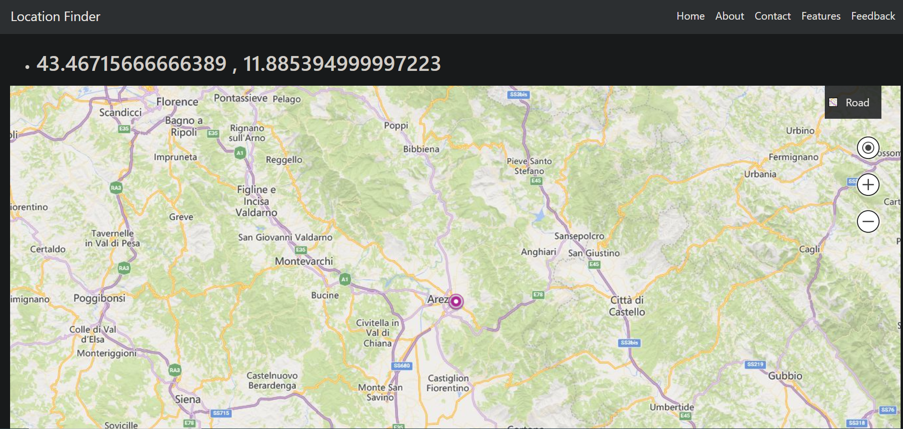
WE ARE CONVERTING IMAGE PATH INTO BINARY

Slide 28
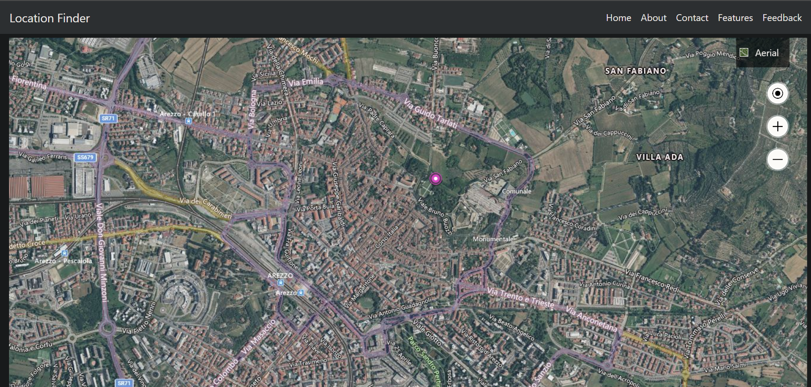
WE ARE CONVERTING IMAGE PATH INTO BINARY

Slide 29
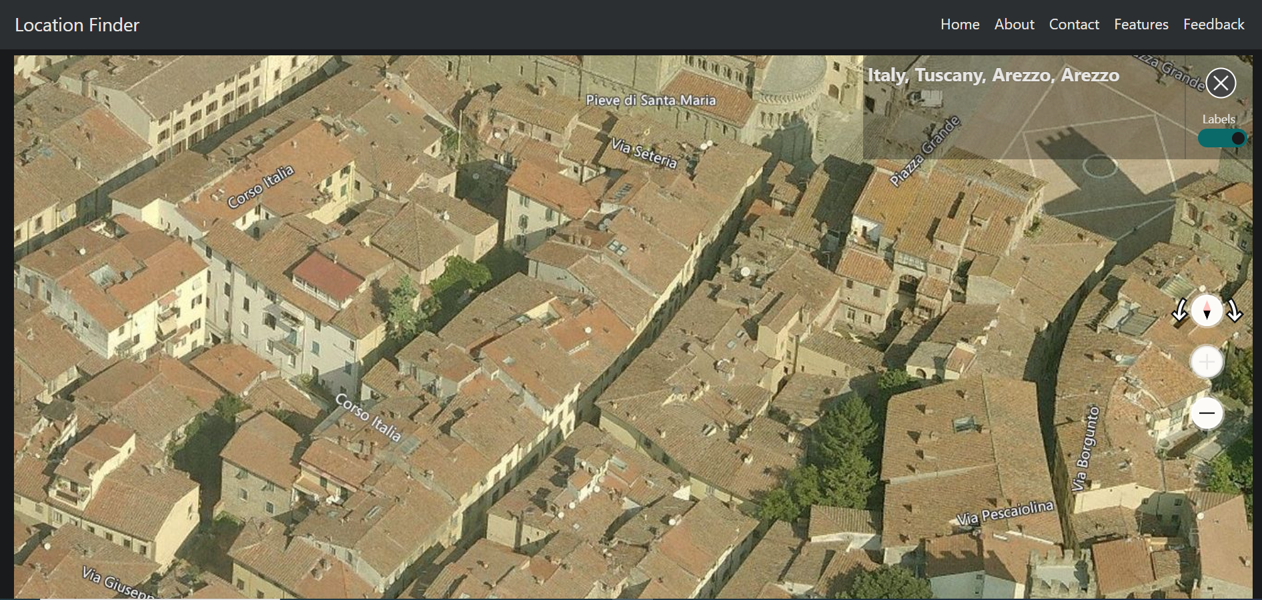
WE ARE CONVERTING IMAGE PATH INTO BINARY

Slide 30

FUTURE WORK
The proposed system has a lot of potential for future improvement and expansion. Some of the possible future scopes are as follows:
1. Integration with social media platforms: Users can share their location and route information with their social media connections, thereby expanding the reach of the app.
2. Voice command input: Adding a voice command input feature can improve the accessibility and ease of use of the app.
3. Integration with smart glasses: Integration with smart glasses can provide a hands-free and immersive experience to the users, enabling them to navigate seamlessly.
4. Real-time traffic updates: Integration with real-time traffic updates can help users to find the fastest and most efficient route to their destination.
5. Augmented Reality (AR) feature: AR can be used to enhance the user experience by providing a real-time view of the user's location and destination.

Slide 31
CONCLUSION
In conclusion, the proposed project aims to create a location-finding app that utilizes image input with EXIF data to provide location and route information. The project is technically, operationally, and economically feasible, and its objective is to provide a user-friendly and efficient alternative to the traditional text-based input location apps. Through the project, we were able to address the limitations of the existing system and come up with an innovative solution to provide better user experience.

Slide 32

REFERENCES
https://betterprogramming.pub/visualising-photo-geolocation-data-using-python-73ac47059112
https://www.codingnepalweb.com/responsive-navigation-menu-bar-css-flexbox/
https://www.codingnepalweb.com/responsive-footer-section-html-css/
https://www.geeksforgeeks.org/how-to-create-links-to-sections-within-the-same-page-in-html/
https://pypi.org/project/exif/
https://www.techbout.com/find-location-where-photo-was-taken-17094/
https://www.photographymad.com/pages/view/exif-data-explained

Slide 33



THANK YOU
Anushree Saha
Manish Pathak
Shivam Mishra
9903125814
pathakmanish8479@gmail.com

